Slide 1


Reduced order heat transfer model to simulate the battery cell thermal runaway propagation within a module
Jinghu hu
PhD Candidate, The University of Texas at Austin

Slide 2
The whole model within one page
Radiation (cell to adjacent cells, cell to air)
Convection
Radiation (cell expansion)
Heating sources from chemical reactions from TRs
TR-caused compartment combustion and consequential heat sources to the cell (added 02/16/2023)
Heat transfers via base and/or electrical connection tab from cell 1 to cell 2 (added 02/16/2023, all other inter-cell heat transfer via bases/tabs currently discarded)

Slide 3
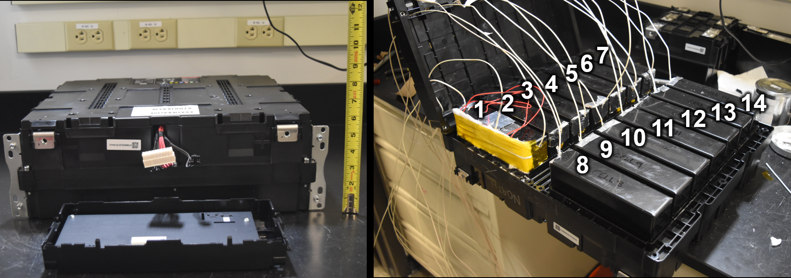
Prismatic cell module TR propagation modeling
Previously the battery cell thermal failure and the propagation of thermal runaway experiment has been carried out and relevant data has been collected
A reduced-order heat transfer model, focusing on the radiation, convection, conduction and enthalpy exchange between cells and surrounding air, could play an important role in simulating the cell-to-cell thermal runaway propagations

Slide 4
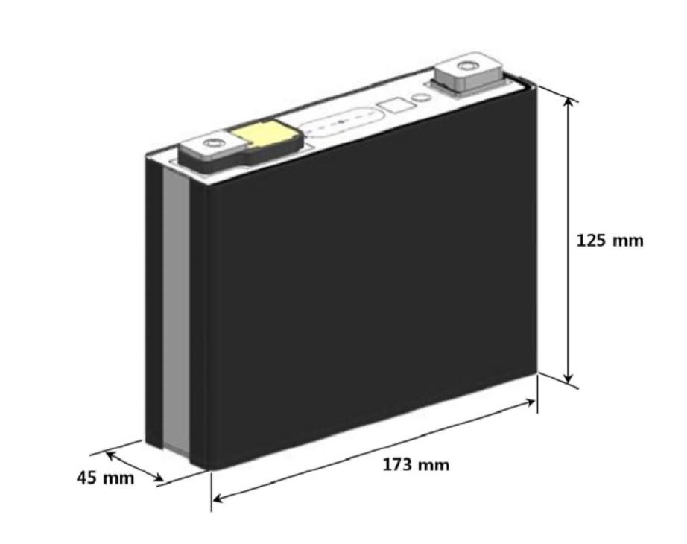
Prismatic cell module TR propagation modeling: experiments
air block
Cell
(1, 1)
Cell
(1, 2)
Cell
(1, n)
L2
…
L1
Cell
(2, 1)
…
Each cell has nominal average capacity of 95.6 Ah
14 cells connected in series in a module compartment

Slide 5
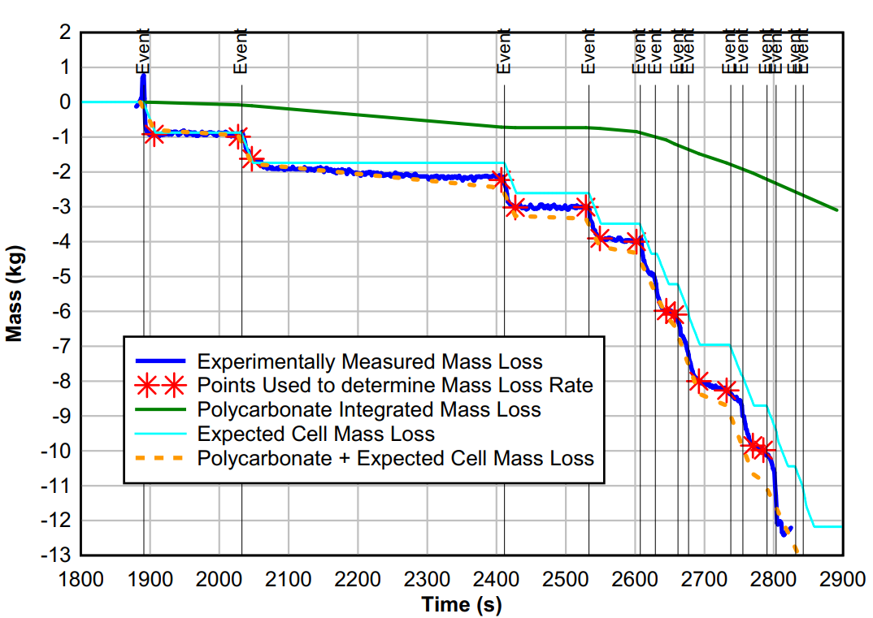
The experimental data to be compared with

Slide 6
Prismatic cell module TR propagation modeling: models
each cell was treated as lumped, and the air block surrounding the cell considered as a whole
It was assumed that the cell would go to TR once the cell lumped temperature reached a certain temperature threshold Tign
Then, the model simplified TR propagation processes to a heat transfer model. If all the heat transfer rate terms were calculated, the temperature profiles of the cell/air would be known; TR propagation profile would be computed
All heat transfer methods were considered:
Radiation (between two cells; between individual cell and air)
Convection between air and the cells
Conduction (due to potential volume expansion of the cell)
Direct enthalpy transfer via gas movement
air block
…
…
…

Slide 7
Detailed assumptions
air block
The manually failed cell at the top left corner was modeled to have a constant heating source until TR took place
For now we assumed 20% of the external heating power went into cell 2 due to electrical connection & base
The pre-TR gas venting was ignored for the current model
Heat release from exothermic chemical reactions was assumed to be strictly accompanied by the gas venting process; both assumed to be start right at the start of TR and end some time later at the same time
Whenever a cell went into thermal runaway, we assumed that there is a local additional heating source (from compartment combustion) lasting for 20 seconds with heating power 5000 W exerting onto the neighboring cell
…
…
…

Slide 8
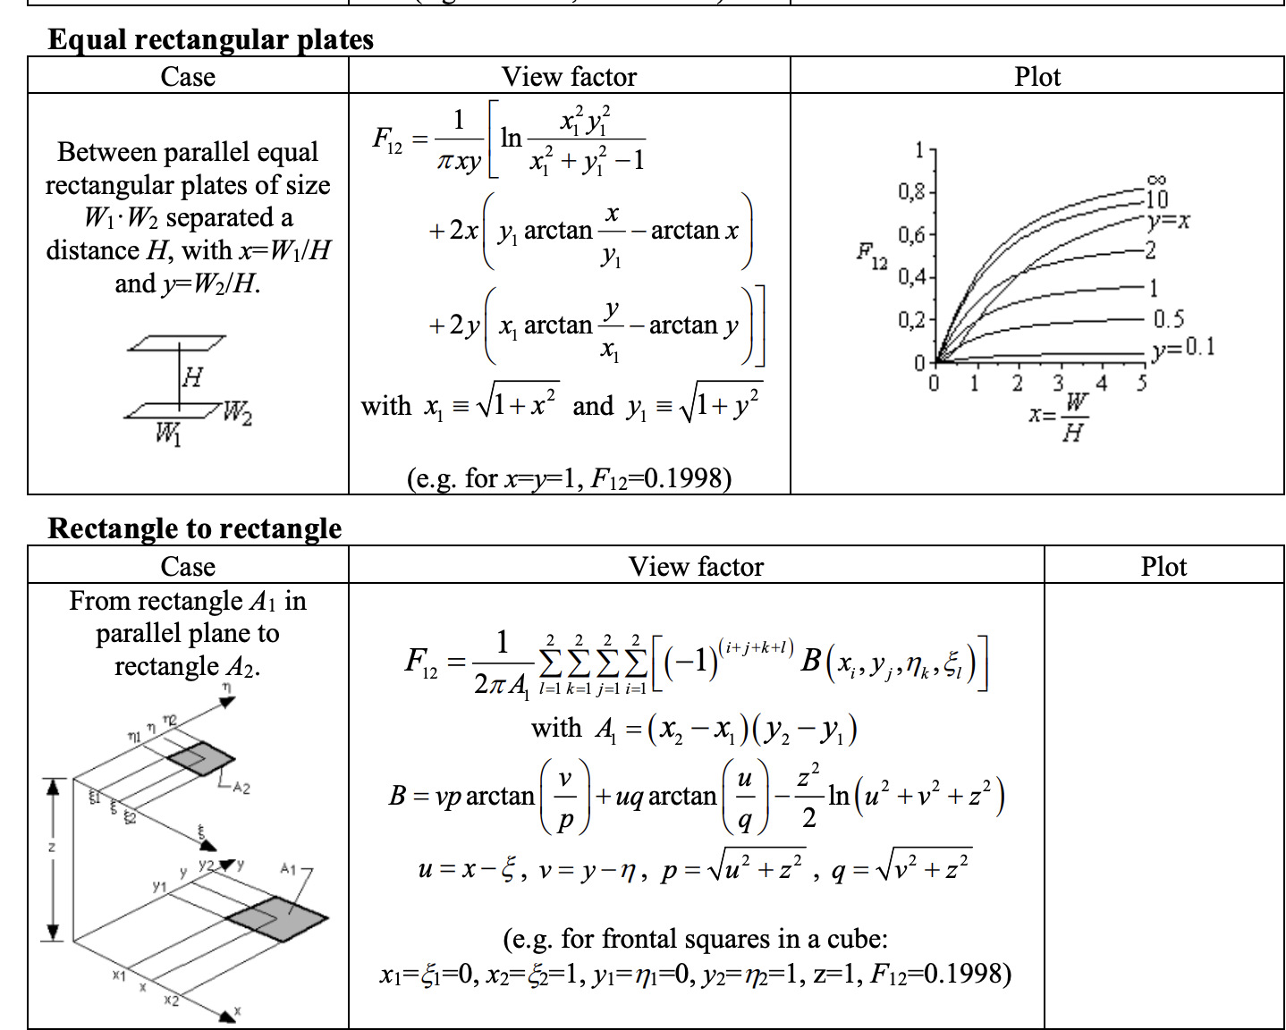
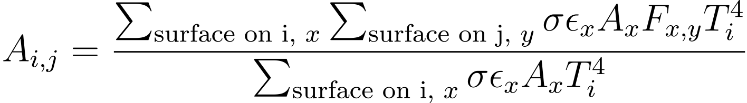
Radiation modeling
A radiation energy transfer matrix A, was calculated: A is a 15x15 matrix in which element Aij represented the proportion of radiated energy rate absorbed by cell j over the total radiation heat release rate from cell i
For battery cells, a certain cell could only “see” the adjacent cells and the air block in terms of radiation. Each Aij was calculated after calculating the radiation area and the view factors
air block
…
…
View Factor calculations: Martinez, I. Radiation View Factors
http://webserver.dmt.upm.es/~isidoro/tc3/Radiation%20View%20factors.pdf

Slide 9
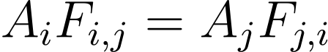
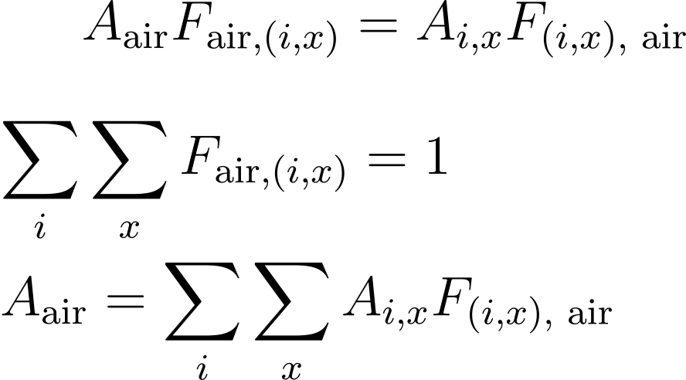
Radiation modeling
For air block, we assumed that the view factors towards every cell were the same:
We then calculated the air “equivalent” radiation area using the rule of reciprocity
air block
…
…
View Factor calculations: Martinez, I. Radiation View Factors
http://webserver.dmt.upm.es/~isidoro/tc3/Radiation%20View%20factors.pdf

Slide 10
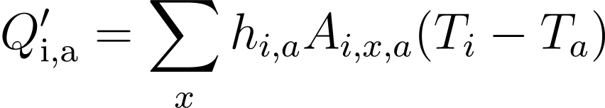
Convection modeling
For convection, we assumed a simple format of Newton law of cooling
The overall convection heat transfer between a certain cell and the air block was calculated to be the product of a pre-determined convection heat transfer coefficient, total area of heat transfer of the cell, and the temperature difference between the cell and the air:
…

Slide 11
Potential Conductions: due to the volume expansion
Cell expansion due to gas production took place before/during TR
Such expansions led to cells being in direct contact with each other, significantly increasing the magnitude of heat transfers
Currently, a processing method would be:
Assuming battery cell to expand to be in almost contact with adjacent cells, only separated by a 1mm-thick air wall
recalculating the radiation transfer matrix; also assuming heat conduction to take place overcoming the air thermal resistance
air block
…
…

Slide 12
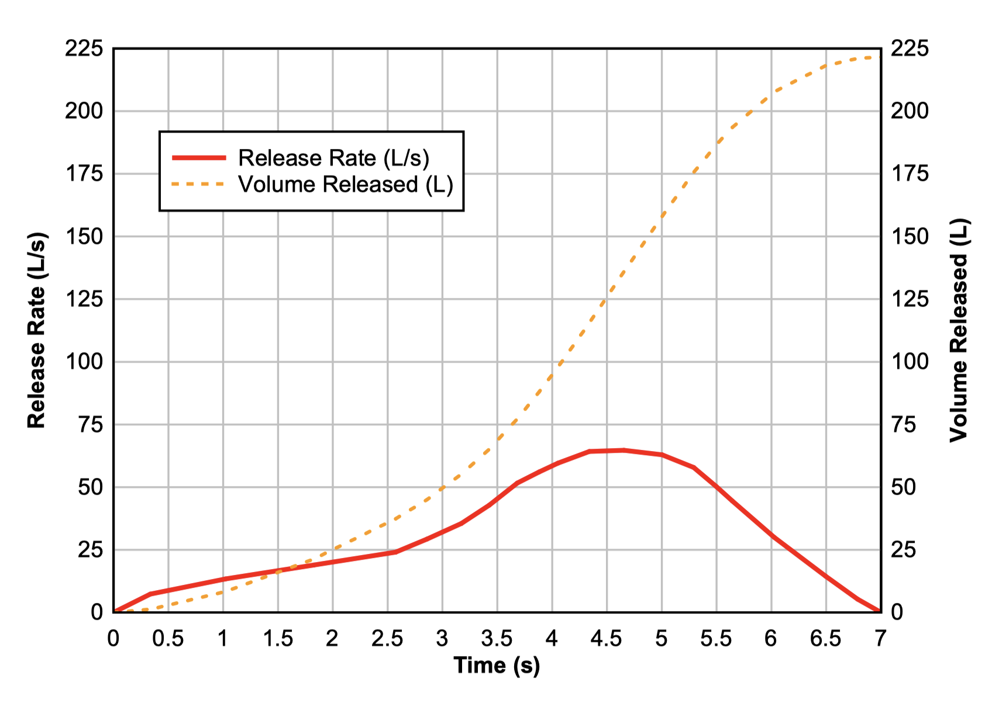
Energy transfer due to mass transfer: enthalpy
During TR, certain amount of gas was vented from the cell
Besides gas, solid particles (which would have weaker heat transfer compared with gas) were also emitted from the cells
The mass loss rate was obtained from experiments; the mass loss rate from gas was calculated from measured volumetric gas venting rate; the mass loss rate from particles was then calculated
The air block was assumed to have constant mass throughout the process: when certain amount of gas vented from into the air block, the same amount of air mass would leave the air block
the cell masses were included as state variables
…
Graphs : Archibald, E. Fire & explosion hazards due to thermal runaway propagation in lithium-ion battery systems
https://repositories.lib.utexas.edu/handle/2152/86761

Slide 13
Prismatic cell module TR propagation modeling: models
Summarizing all the assumptions and equations, the main equations were obtained:
Some parameters were to be obtained from experimental data:
Heat source term from thermal runaway
Specific heat for each cell
…
The other parameters are to be be estimated using optimization tools (like pymoo) that would build an optimizer and try to minimize the MSE between simulation results and experimental results

Slide 14
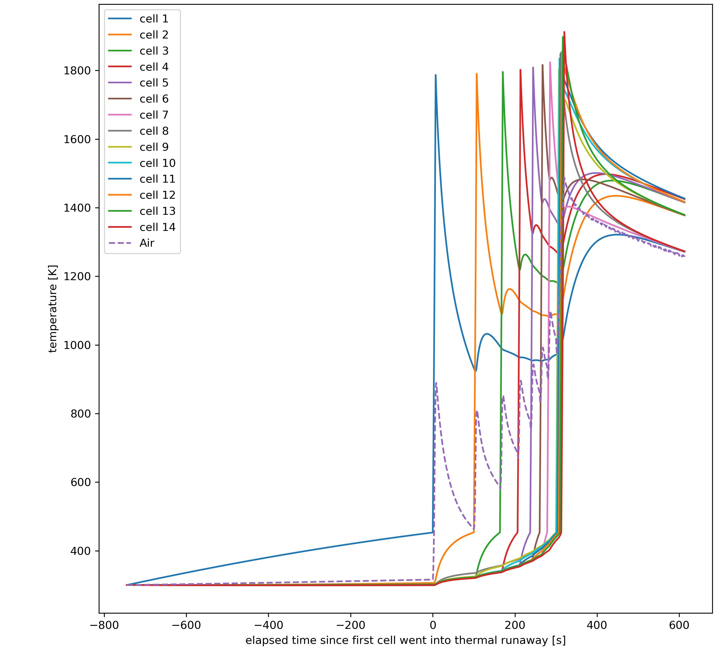
Preliminary Results
The TR propagates in an increasing rate: it took less and less time for next cell to be failed by the previous cell(s)
The TR propagated along the width direction first, before propagated to the second row
The final 5 cells failed almost simultaneously: the propagation time between each cell < 10 s

Slide 15
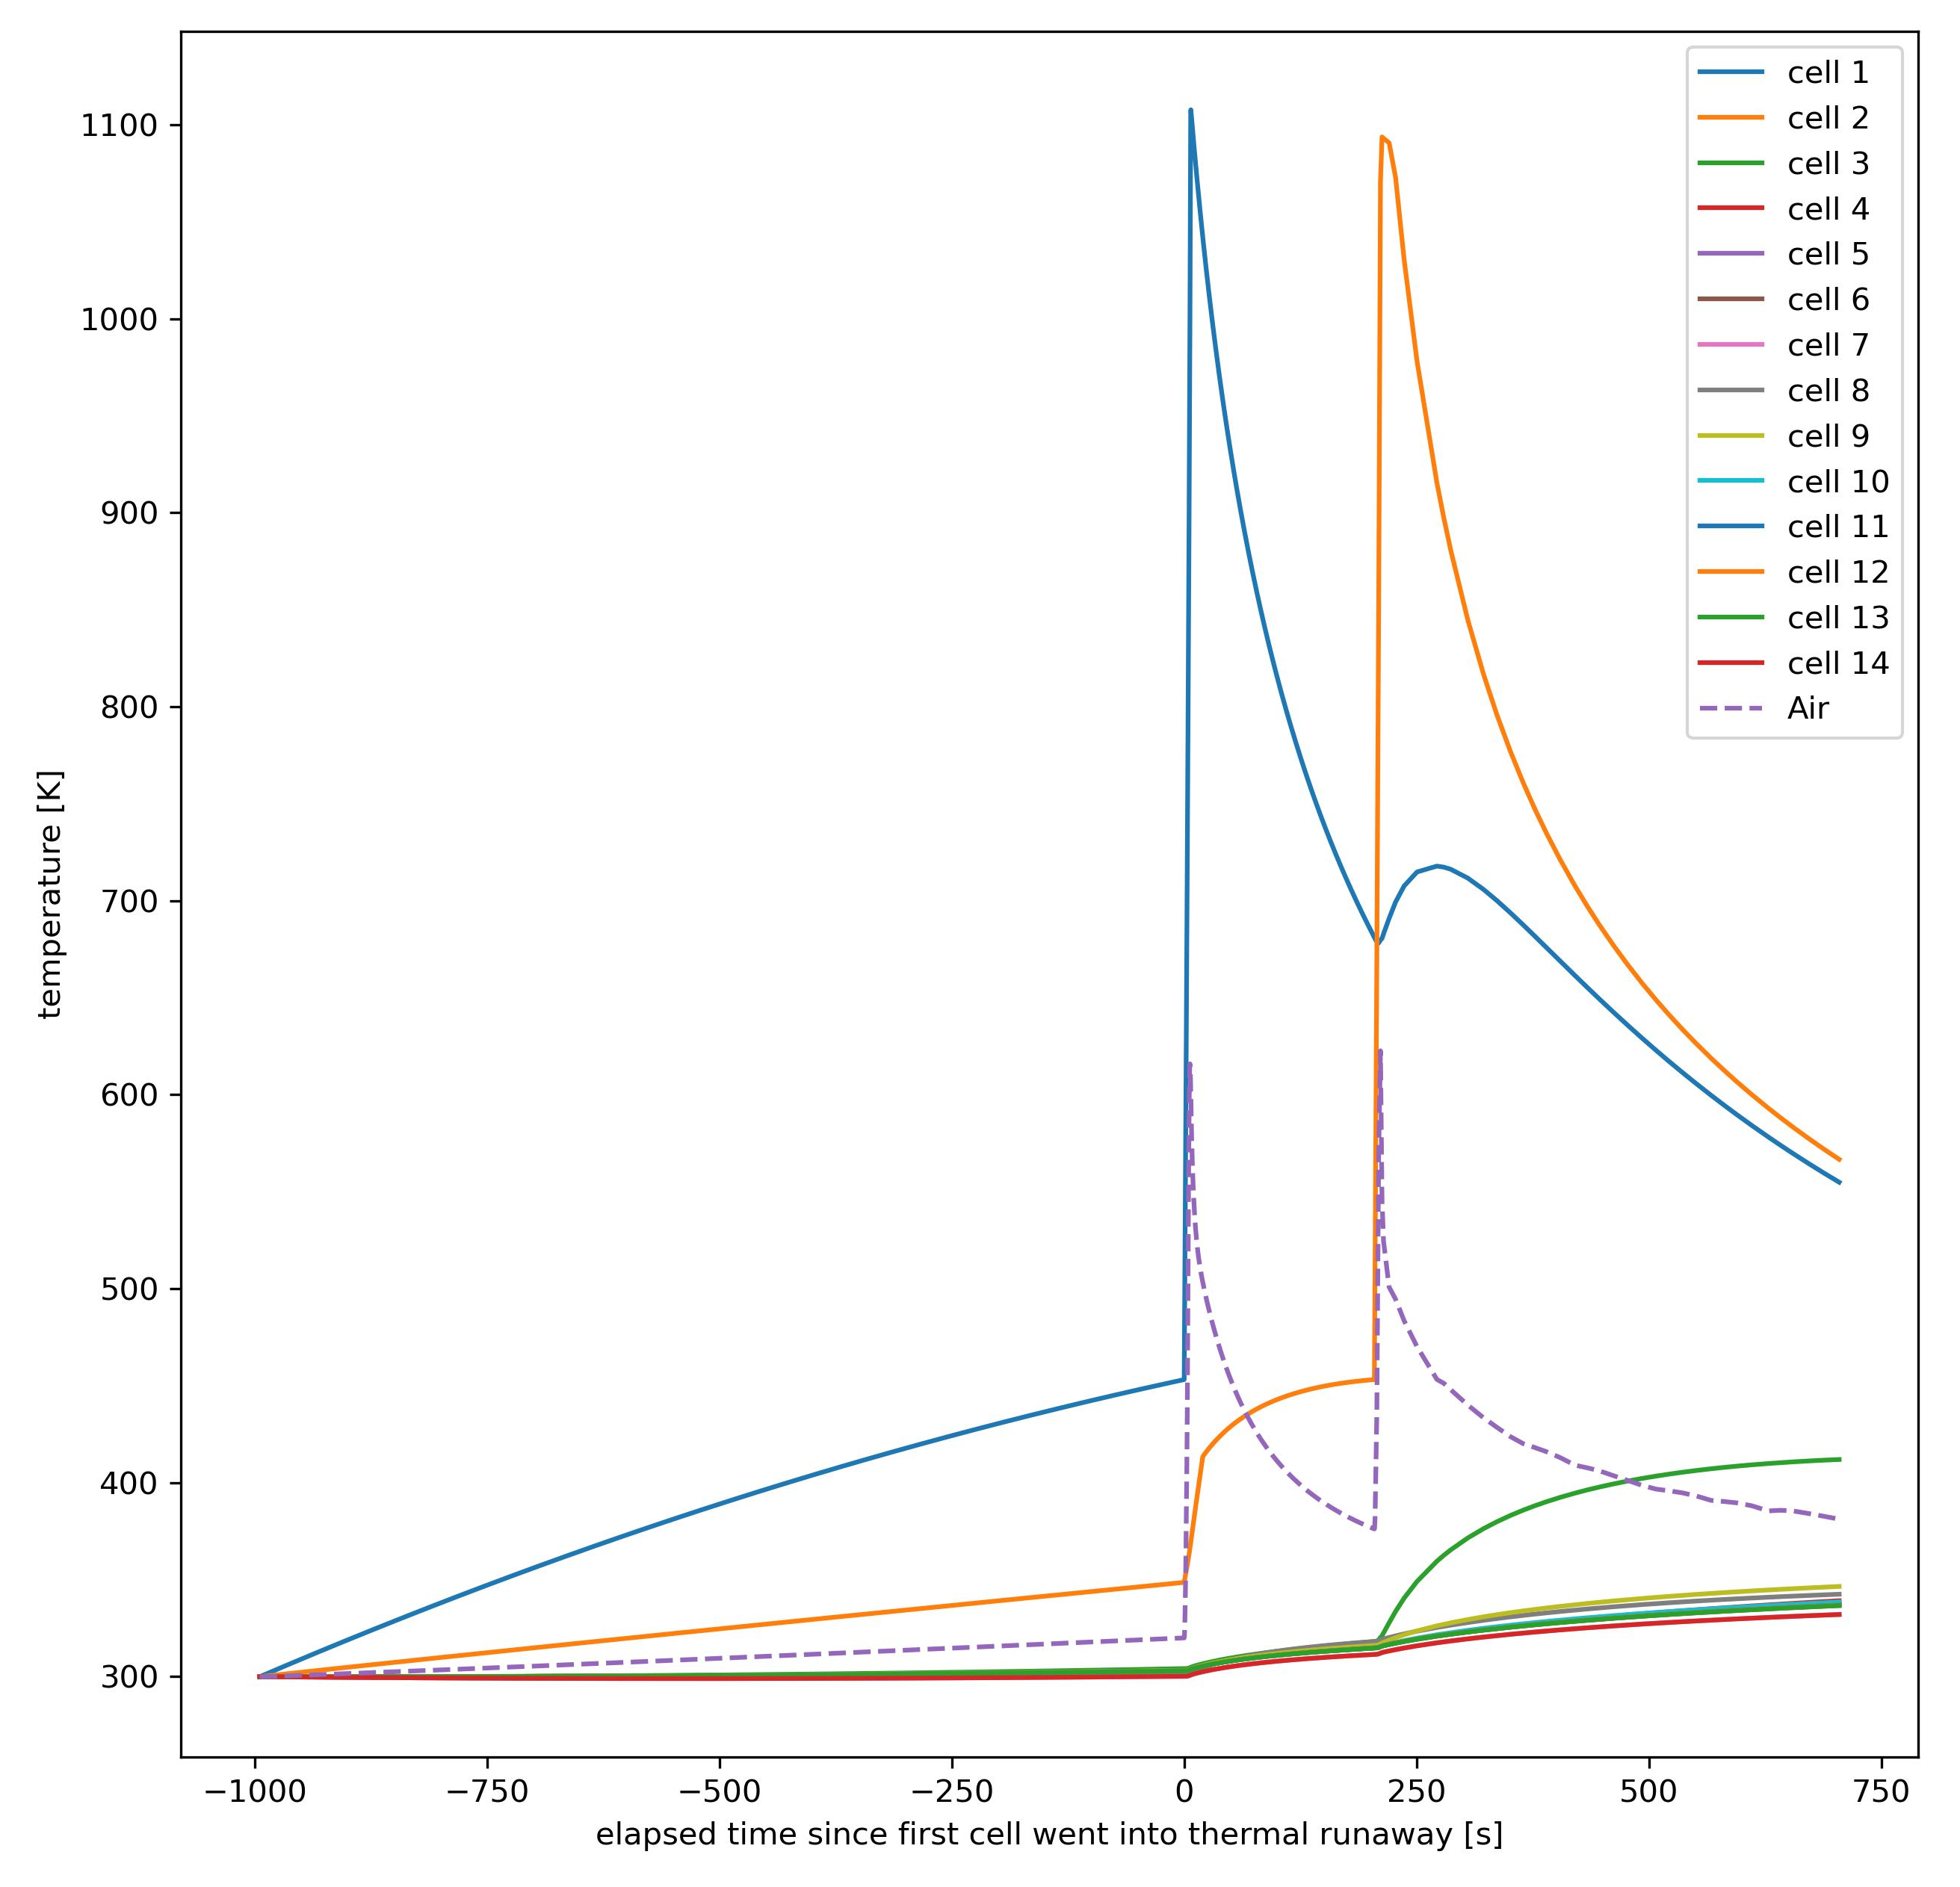
Preliminary Results
The TR propagates in an increasing rate: it took less and less time for next cell to be failed by the previous cell(s)
The TR propagated along the width direction first, before propagated to the second row
The final 5 cells failed almost simultaneously: the propagation time between each cell < 10 s

Slide 16
Preliminary Results
The TR propagates in an increasing rate: it took less and less time for next cell to be failed by the previous cell(s)
The TR propagated along the width direction first, before propagated to the second row
Current simulation model on: https://github.com/elternativeht/battery_tr_propagation_model
…
…

Slide 17
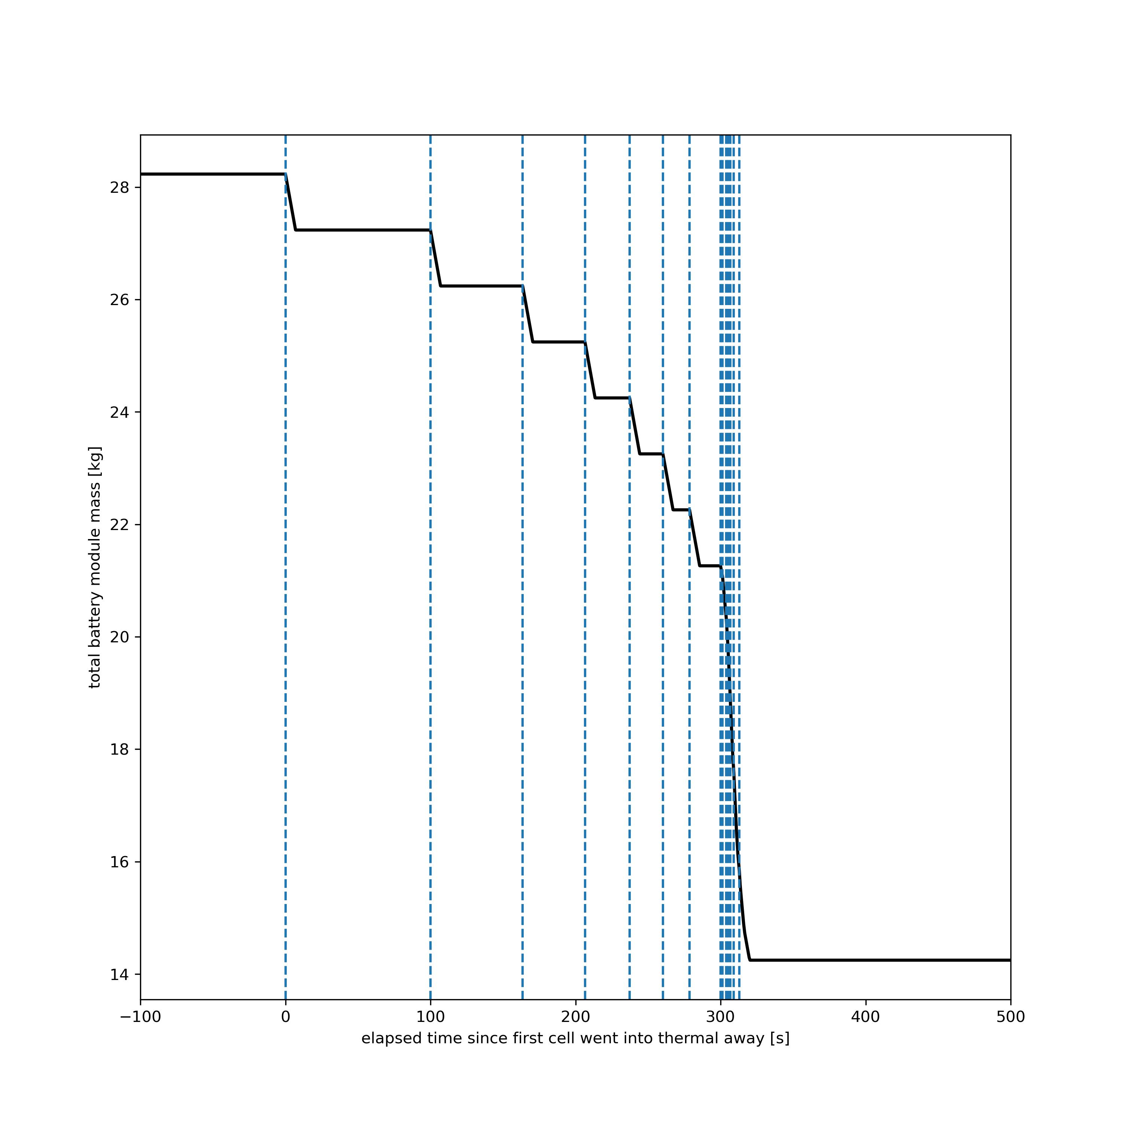
Preliminary Results
The TR propagates in an increasing rate: it took less and less time for next cell to be failed by the previous cell(s)
The TR propagated along the width direction first, before propagated to the second row
Current simulation model on: https://github.com/elternativeht/battery_tr_propagation_model

Slide 18
What can be done to make our results publishable
Refine the potential model using real battery experimental geometries
Identify the parameters that can be estimated from existing results, as well as the parameters whose values are to be obtained from the existing parameter estimation routine
Finish the modeling pipeline; bridge the gap between current model and the parameter estimation subroutine; obtain the optimal data set; compare the results with experimental data

